Slide 1
VENTURETECH
OUR TEAM
SERVICES
TECHNOLOGY
What sets VENTURETECH apart from your internal team? With access to a large talent pool, we partner with you to complete overwhelming, large-scale data projects quickly, saving you internal resources.
Notes:
What sets VENTURETECH apart from your internal team? With access to a large talent pool, we partner with you to complete overwhelming, large-scale data projects quickly, saving you internal resources.

Slide 2
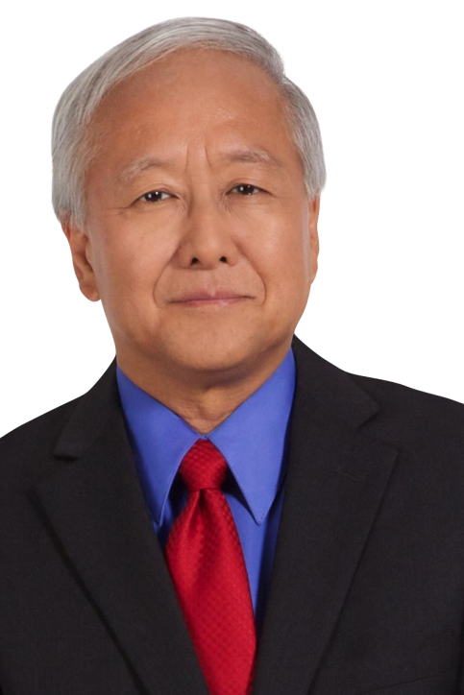
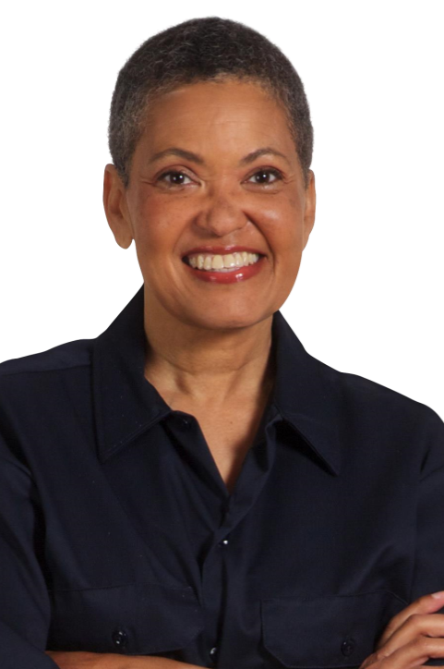
OUR TEAM
MIKE ANDERSON
SARAH ENDERS
LUCY MEEKER
VP, Technical Services
Manages the technical transition team.
VP, Communications
Oversees all customer communication.
Community Manager
Develops and manages community marketing.
Notes:
VENTURETECH is the industry leader in a multi-billion dollar market, providing clients with on-demand access to a skilled and scalable workforce. We manage crowd-based talent to deliver content, moderation and transcription solutions to enterprise clients worldwide.

Slide 3
OUR SERVICES
INFORMATION TECHNOLOGY
We look at issues strategically. Our experts provide an objective and independent perspective.
CONTENT MARKETING
Our e-commerce writers focus on feature benefit content to drive customers to checkout.
COMMUNITY MANAGEMENT
Manage your community’s reputation through consistent, unbiased moderation of comments in real-time.

Slide 4
TECHNOLOGY
INFORMATION TECHNOLOGY
We look at issues strategically. Our experts provide an objective and independent perspective.

