Slide 1
New Hire Orientation

Slide 2
ORGANIZATION

Slide 3
HQ Executive Team
Simon Lodine, PhD
CEO
Jason Hemlock, PE
Principal Design Engineer
June-Su Woo, JD
Legal Counsel
Reggie Tupp
Administrative Assistant
Sally Kerner, MBA
CFO
Robert Molina
Lead Solar Installation Technician

Slide 4
Employees By Facility

Slide 5
HQ Employee Roles
Role | Primary Responsibilities
Administrative Assistant | Answer phone, gatekeeper to executives, manage schedule
Marketing Specialist | Write press releases, organize events, serve as media contact
Product Manager | Manage individual product development from cradle to grave
Sales Representative | Manage enterprise sales accounts and client relations
Social Networking Specialist | Maintain Facebook, Twitter, LinkedIn, and YouTube accounts
Product Engineer | Manage development of products from cradle to grave
Product Technician | Write installation manuals and specification sheets
Legal Counsel | Provide legal advice and support for all Headquarters activities
IT Technician | Maintain website, server, and all computer systems

Slide 6
PRODUCTS

Slide 7
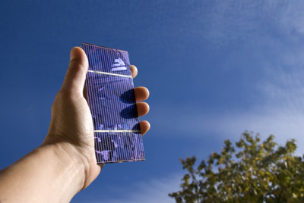
Top Selling Products
K-Eco Mini Panel
K-Eco Low Flow Shower Head
K-Eco Energy Bulb
K-Eco Solar Panel
Please make a selection.

Slide 8
K-Eco Mini Panel
The 4”x 3” K-Eco Mini Panel takes only 6 to 10 hours to charge in partial to full sun, and provides up to 20 hours of power for portable music players, phones, and game consoles.

Slide 9
MARKETING

Slide 10
Social Networking

Slide 11
QUIZ

Slide 12
Thanks for participating in the training! Wishing you much happiness and success in your new career!

