Slide 1

New Hire Orientation

Slide 2
ORGANIZATION

Slide 3
HQ Executive Team
Simon Lodine, PhD
CEO
Jason Hemlock, PE
Principal Design Engineer
June-Su Woo, JD
Legal Counsel
Reggie Tupp
Administrative Assistant
Sally Kerner, MBA
CFO
Robert Molina
Lead Solar Installation Technician

Slide 4
Employees By Facility

Slide 5
HQ Employee Roles
Role | Primary Responsibilities
Administrative Assistant | Answer phone, gatekeeper to executives, manage schedule
Marketing Specialist | Write press releases, organize events, serve as media contact
Product Manager | Manage individual product development from cradle to grave
Sales Representative | Manage enterprise sales accounts and client relations
Social Networking Specialist | Maintain Facebook, Twitter, LinkedIn, and YouTube accounts
Product Engineer | Manage development of products from cradle to grave
Product Technician | Write installation manuals and specification sheets
Legal Counsel | Provide legal advice and support for all Headquarters activities
IT Technician | Maintain website, server, and all computer systems

Slide 6
PRODUCTS

Slide 7
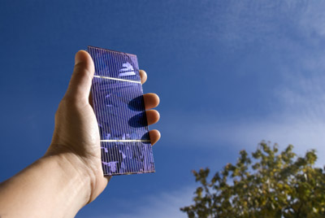



Top Selling Products
K-Eco Mini Panel
K-Eco Low Flow Shower Head
K-Eco Energy Bulb
K-Eco Solar Panel
Please make a selection.

Slide 8


K-Eco Mini Panel
The 4”x 3” K-Eco Mini Panel takes only 6 to 10 hours to charge in partial to full sun, and provides up to 20 hours of power for portable music players, phones, and game consoles.

Slide 9
MARKETING

Slide 10
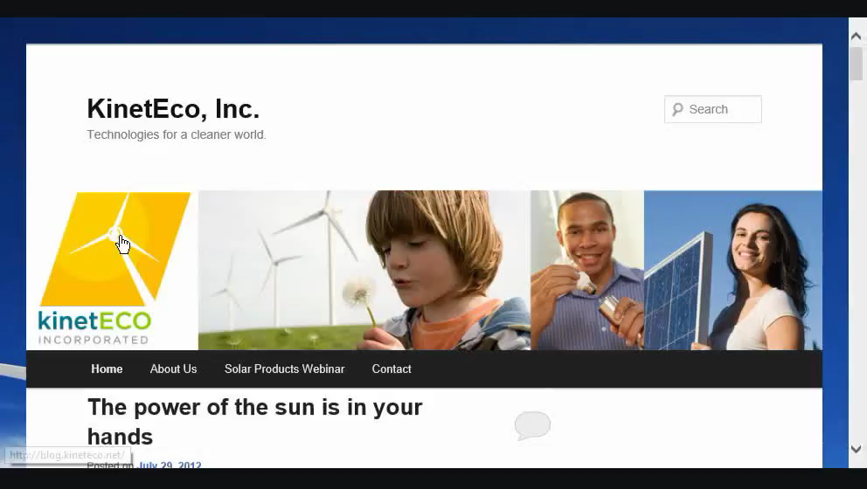
Social Networking

Slide 11
QUIZ

Slide 12
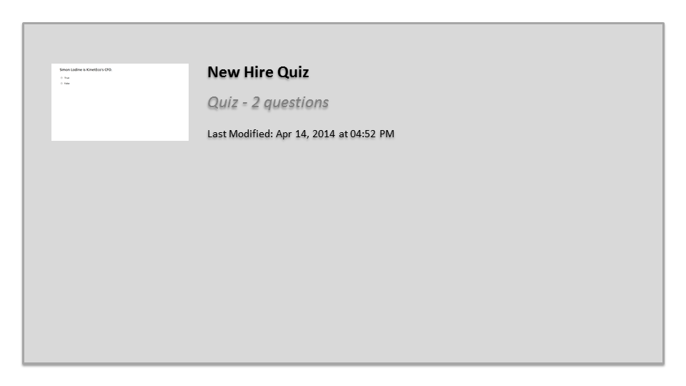
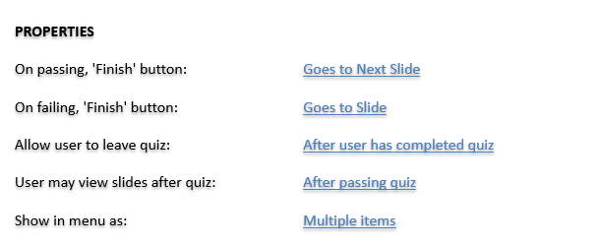


New Hire Quiz

Slide 13
Thanks for participating in the training! Wishing you much happiness and success in your new career!

Slide 14
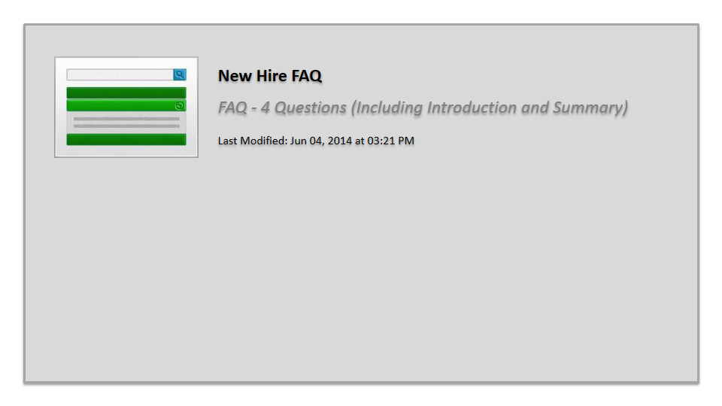
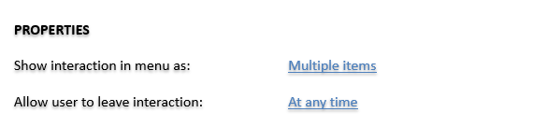

New Hire FAQ

